Slide 1

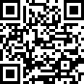
Parasitic Circus: On the Feasibility of Golden-free PCB Verification
Maryam Saadat Safa, Patrick Schaumont, Shahin Tajik
New England Hardware Security Day
April 5th , 2024

Slide 2






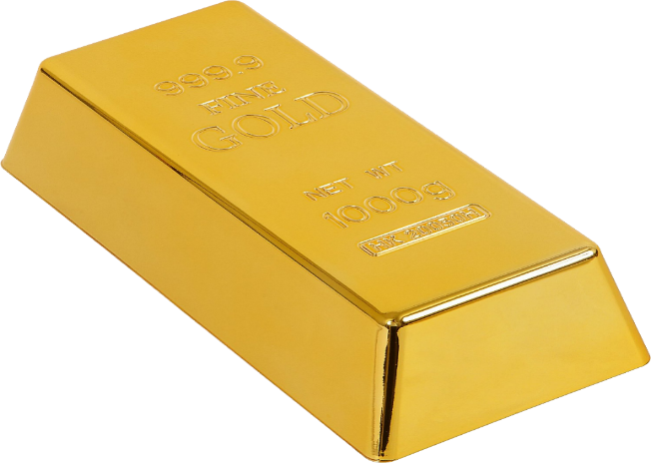






Tamper Detection Methods
Imaging Techniques
Counterfeit
Supply Chain’s Threats
Side-Channel Analysis
Physical Golden Sample
Impedance Analysis
2

Slide 3
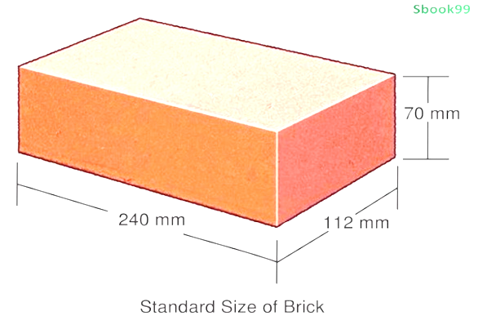

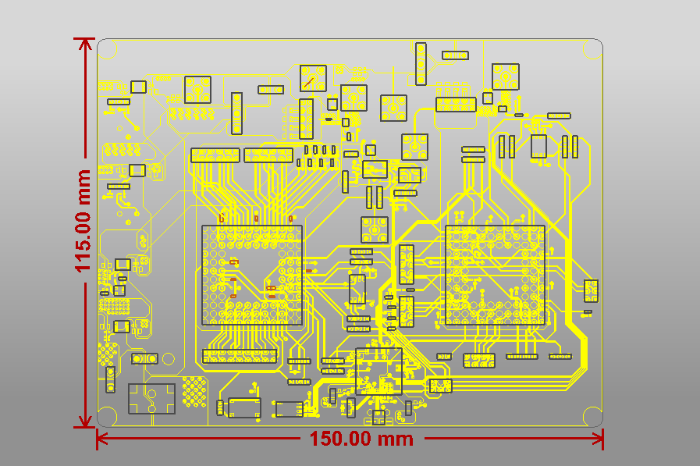
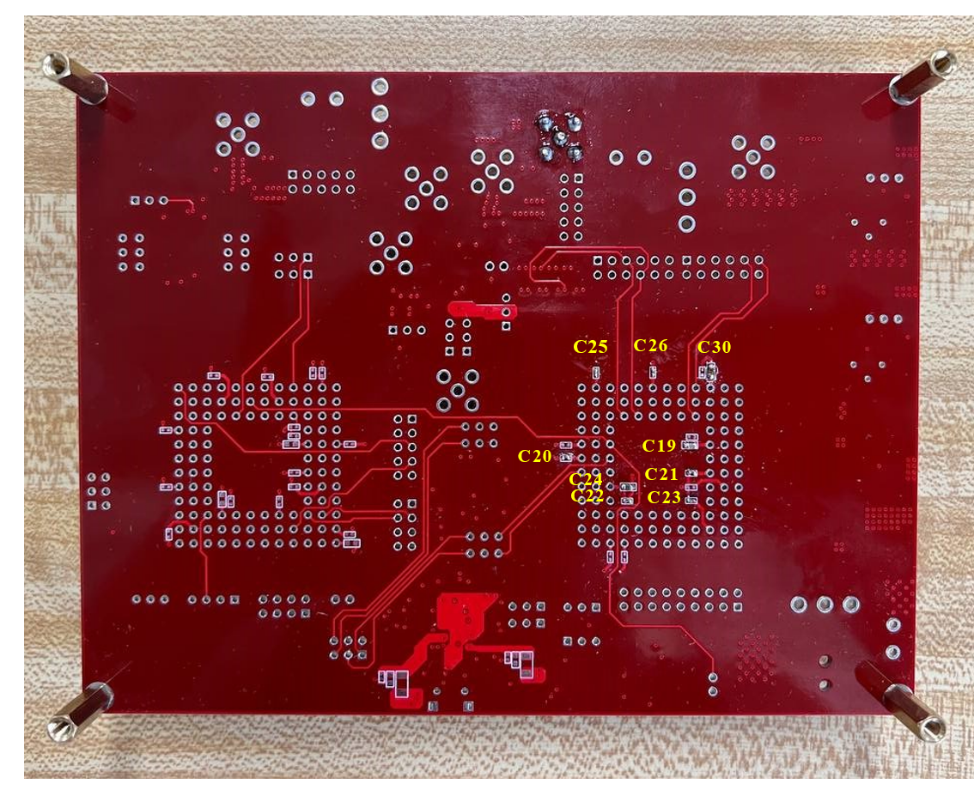
Using Simulated Design Files to Obtain Golden Signature
GOLD
Parasitic Impedance:
ESL
ESR
CP

Slide 4
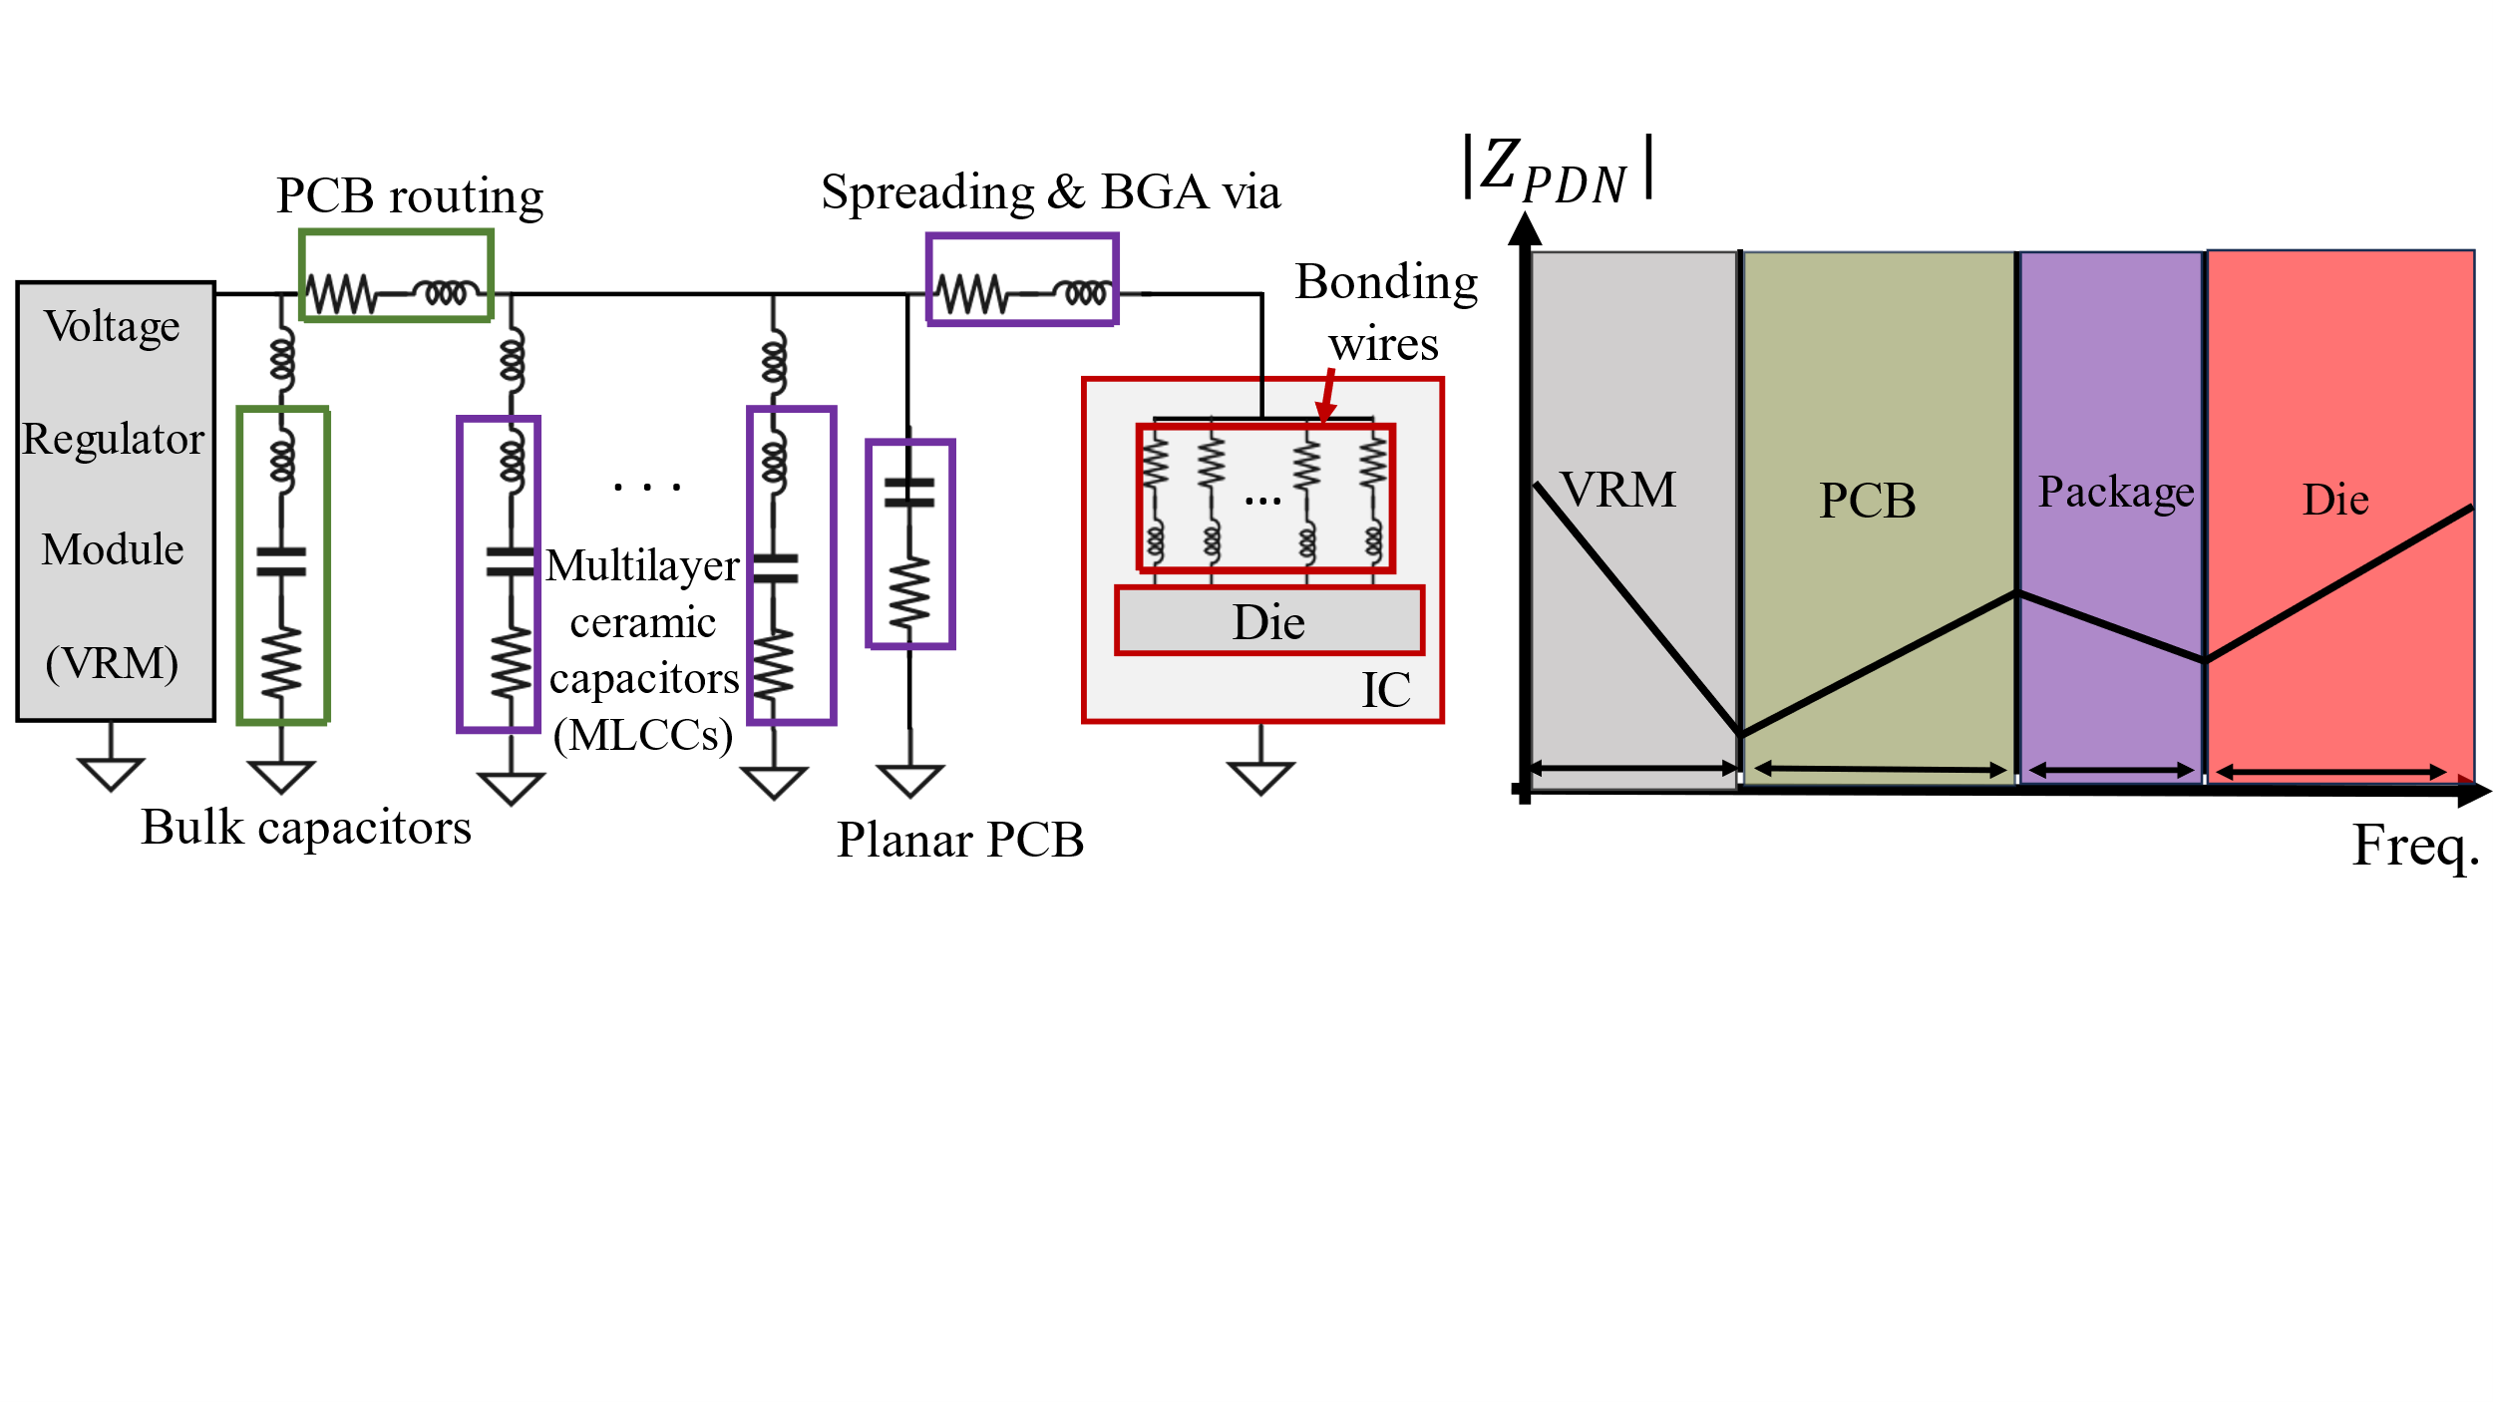
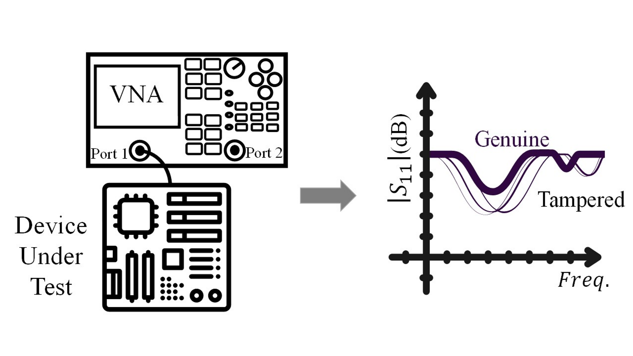
Power Delivery Network (PDN) Impedance Characterization
Equivalent RLC Network for a PCB
The Impedance of Various Components Can Be Observed at Different Frequency Bands

Slide 5
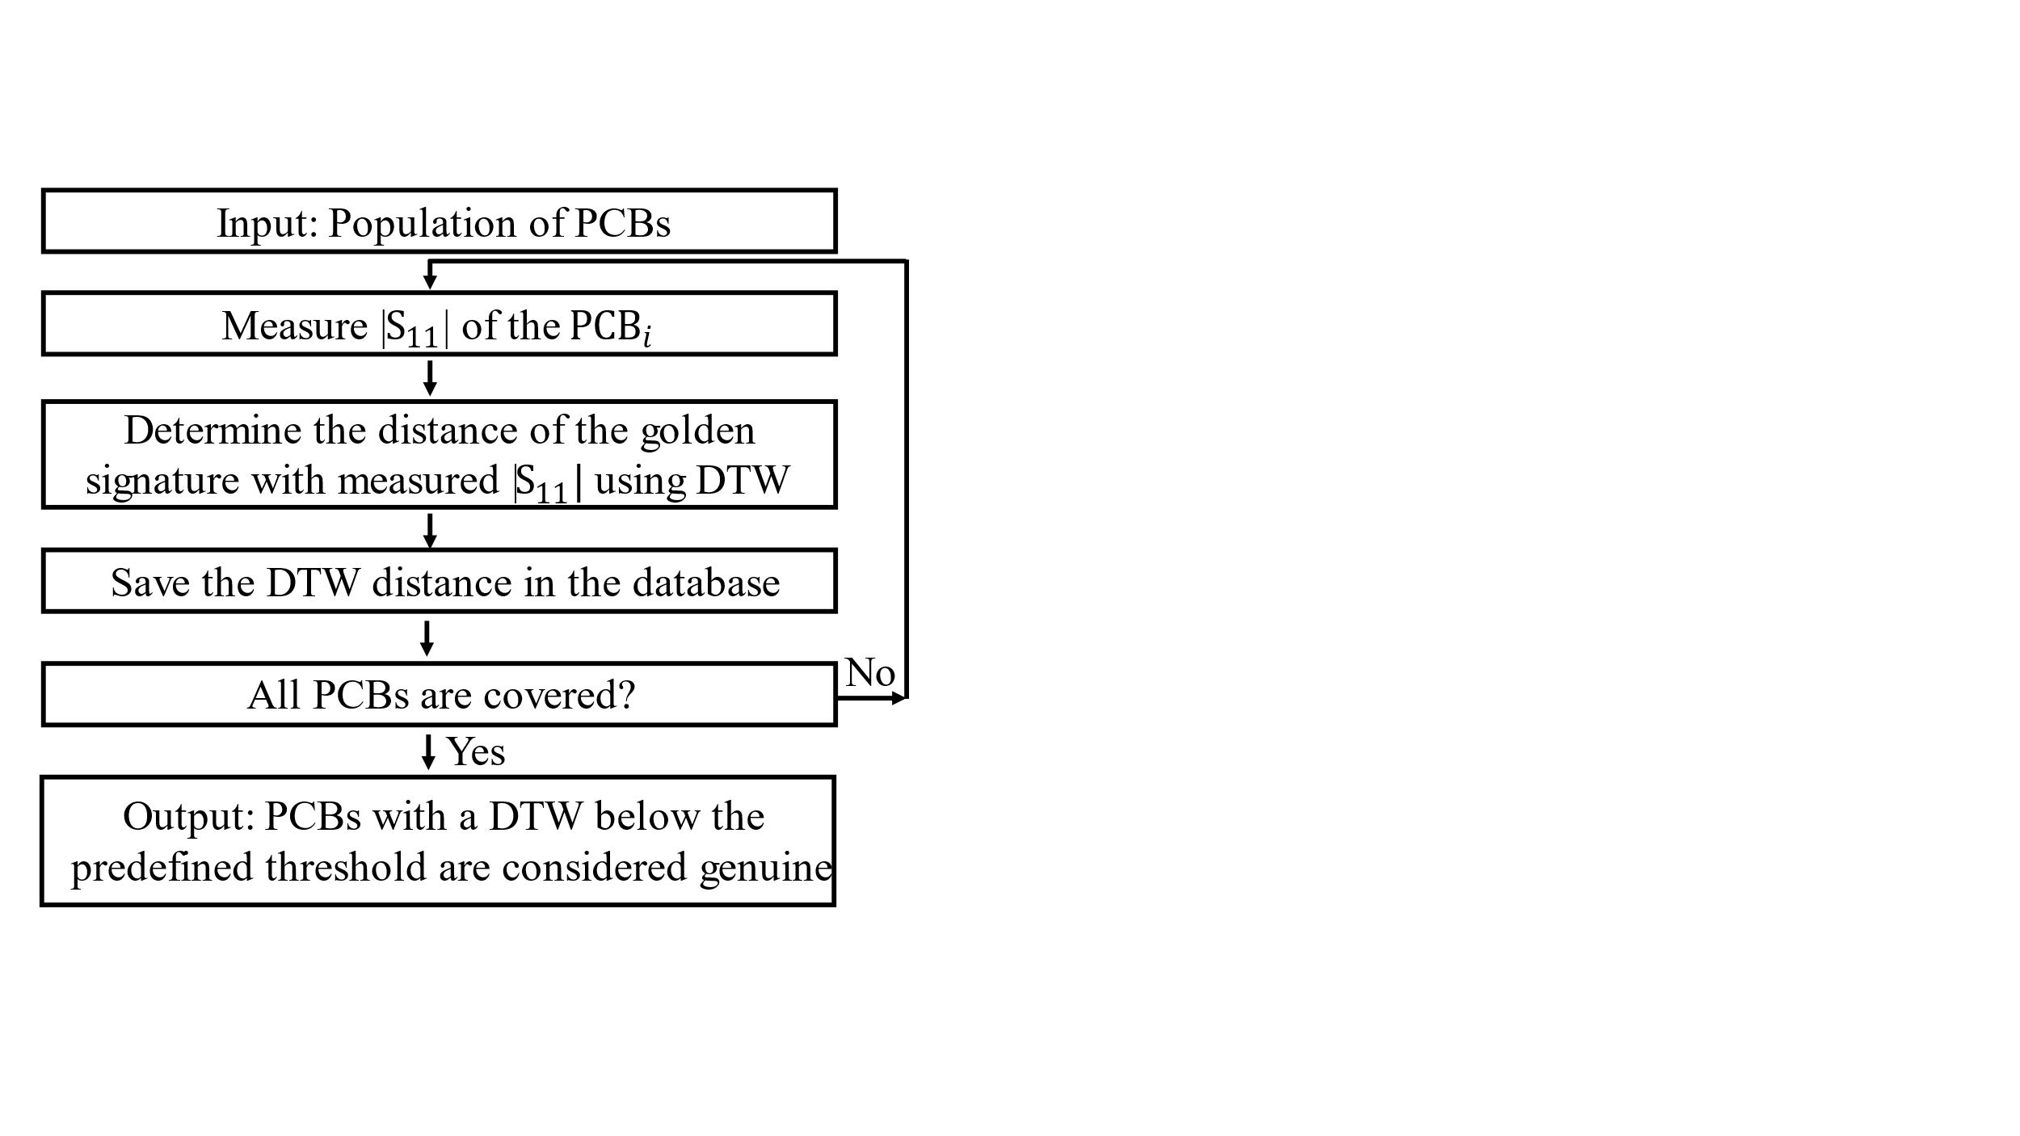
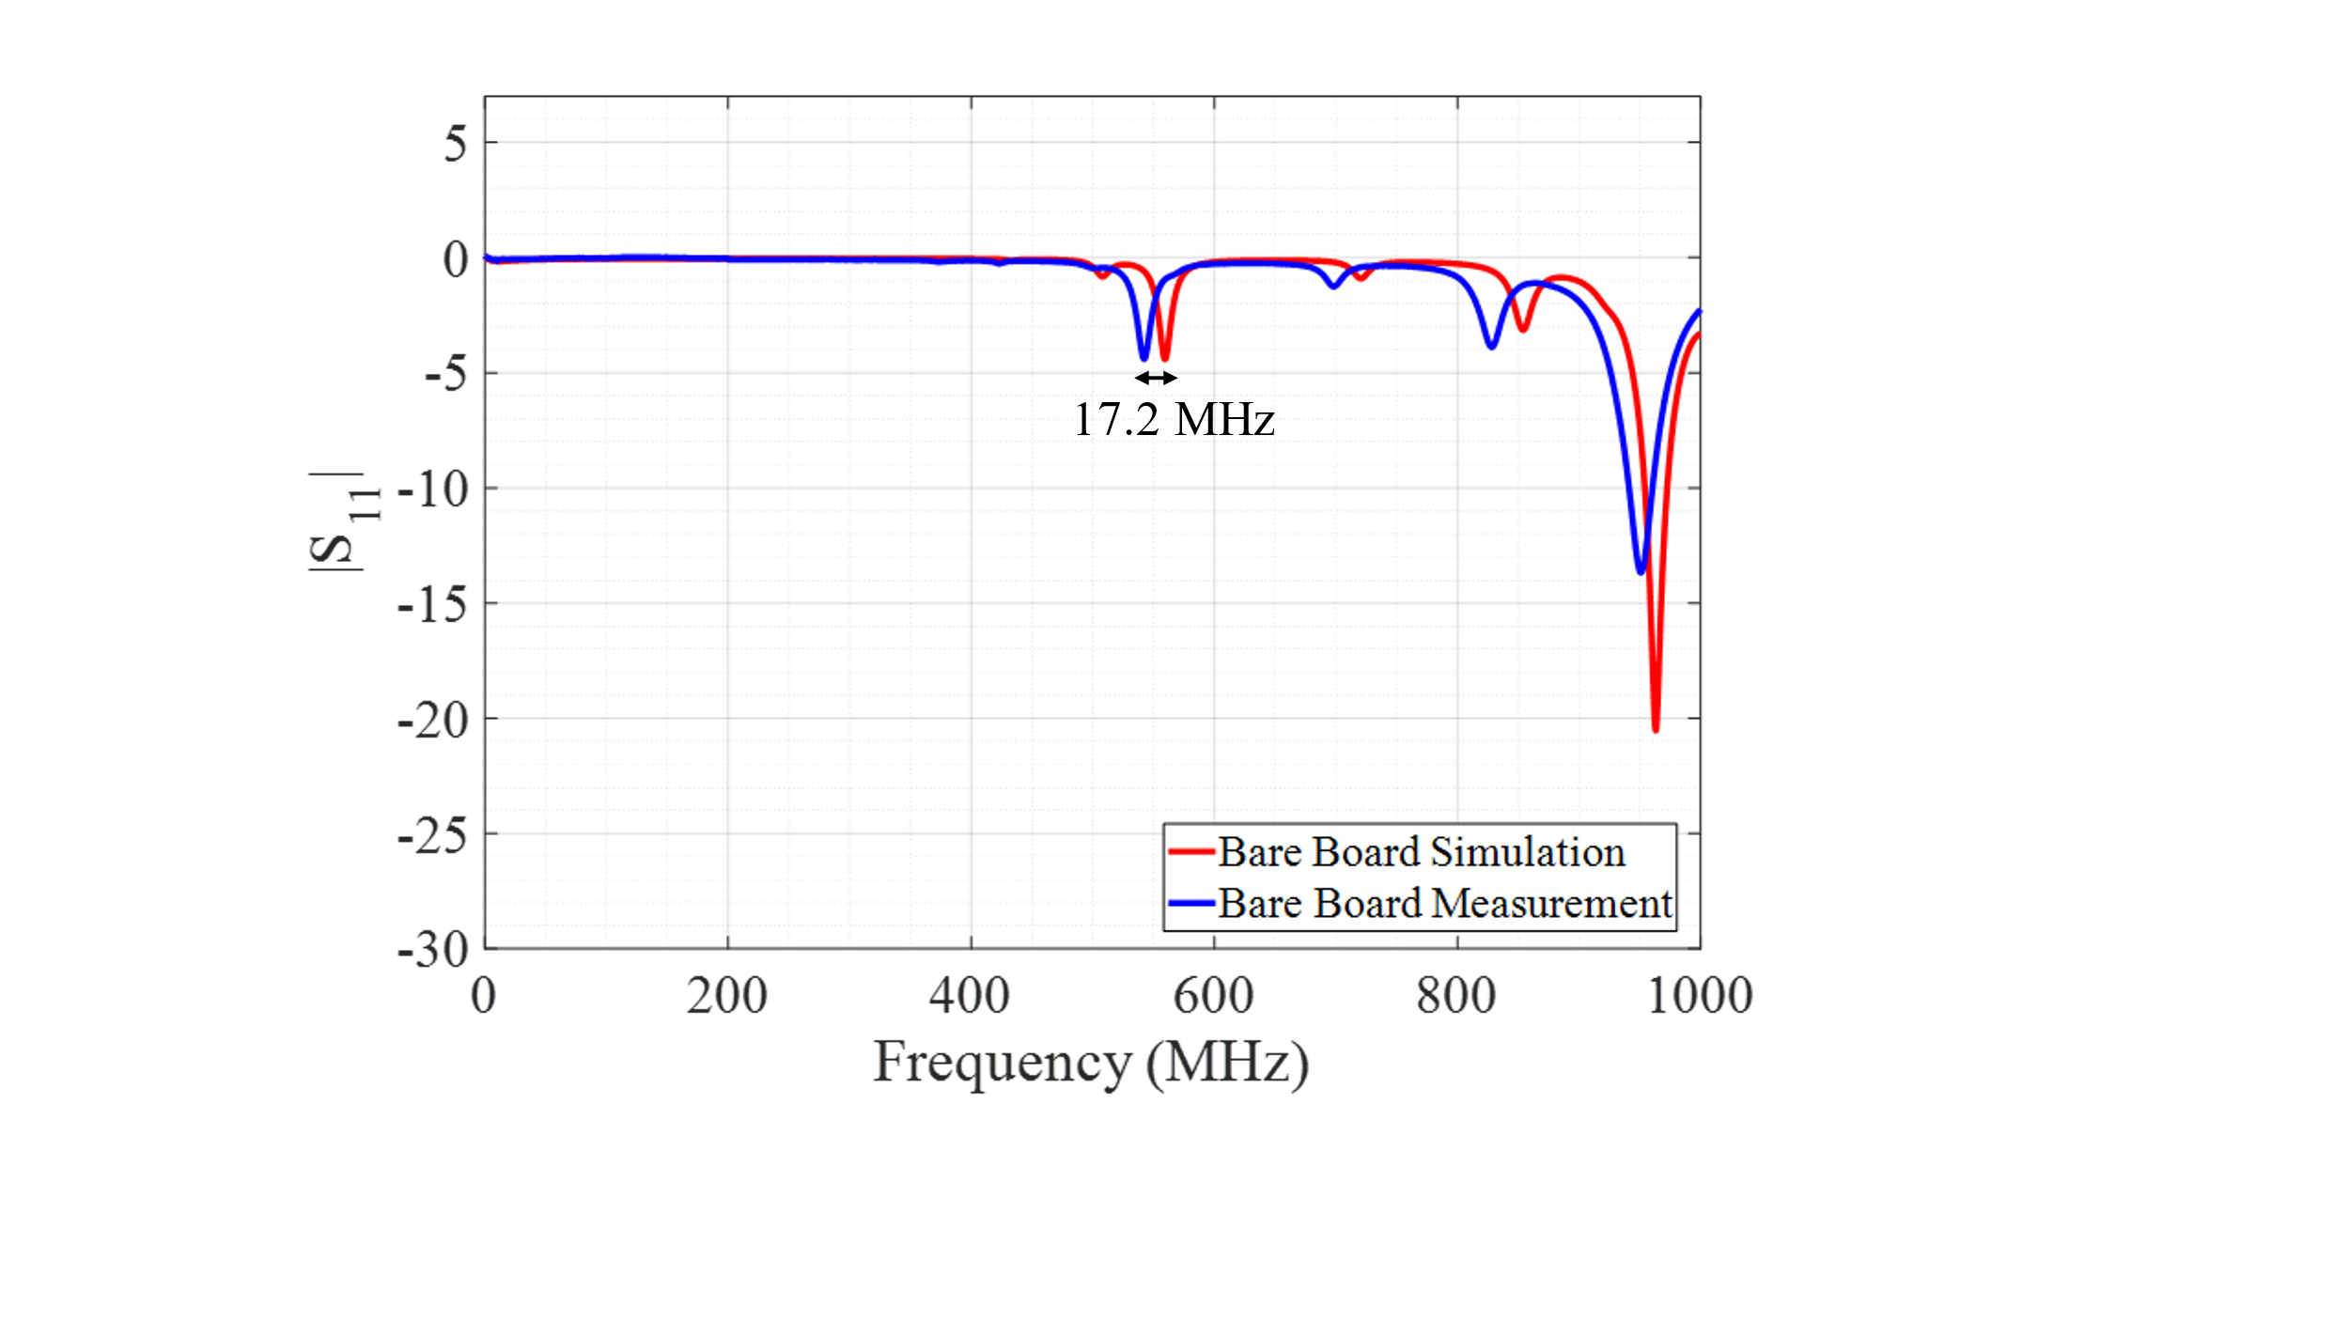
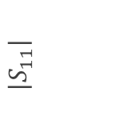
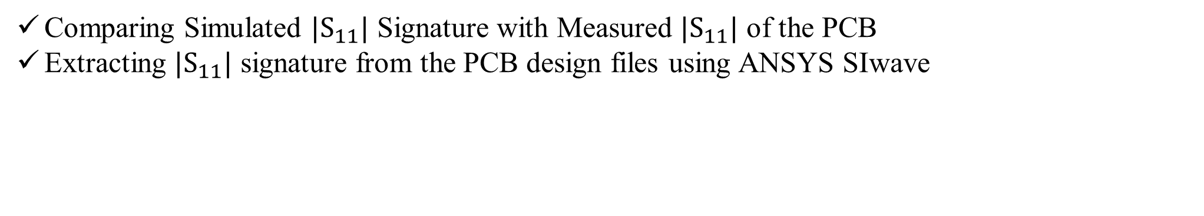
Golden-free Tamper Detection Method
Comparing Simulated $|S_{11}|$ Signature with Measured $|S_{11}|$ of the PCB
Extracting $|S_{11}|$ signature from the PCB design files using ANSYS SIwave
$$|S_{11}|$$

Slide 6
Detection of Addition/Removal of Components
Setting the Actual Values for Parasitic Impedance of the PCB’s Components in the Simulation
EX 1
EX 2
EX 3
EX 4
EX 5
EX 6
Reference Test | Bare Board (S) | 2 CAPS (S) | 3 Caps (S) | 5 Caps (S) | 7 Caps (S) | 9 Caps (S)
Bare Board (M) | 189 | 1247 | 1250 | 1316 | 1295 | 1264
2 CAPS (M) | 1291 | 23.8 | 33 | 1316 | 1270 | 1239
3 CAPS (M) | 1283 | 41.8 | 30 | 1329 | 1286 | 1261
5 CAPS (M) | 1308 | 1224 | 1227 | 21.3 | 715 | 1211
7 CAPS (M) | 1305 | 1232 | 1235 | 60.2 | 170 | 1210
9 CAPS (M) | 1205 | 1247 | 1251 | 1331 | 1263 | 212
DTW Score

Slide 7
Thank You!

Slide 8
Conclusion
Exploring the feasibility of using simulated golden signatures as a substitute
for the physical ones
Given actual values for the parasitic impedance of components, using simulated
signature is feasible
For the intended PCB application, the verifier adjusts component’s parasitic tolerances
to get a threshold
Sophisticated tampering detection demands higher parasitic impedance accuracy

Slide 9
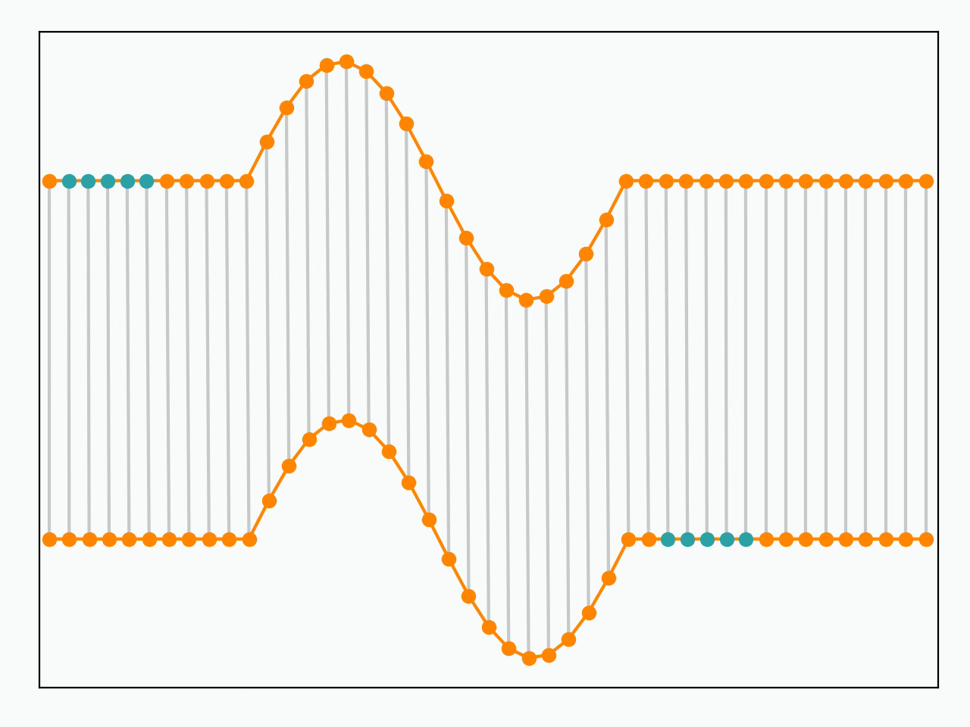
Dynamic Time Warping (DTW)

Slide 10
Comparison of Simulated and Measured Traces
2 Capacitors added to the system
Having Approximated values for ESL and ESR
Having significant deviation for ESL and ESR

Slide 11
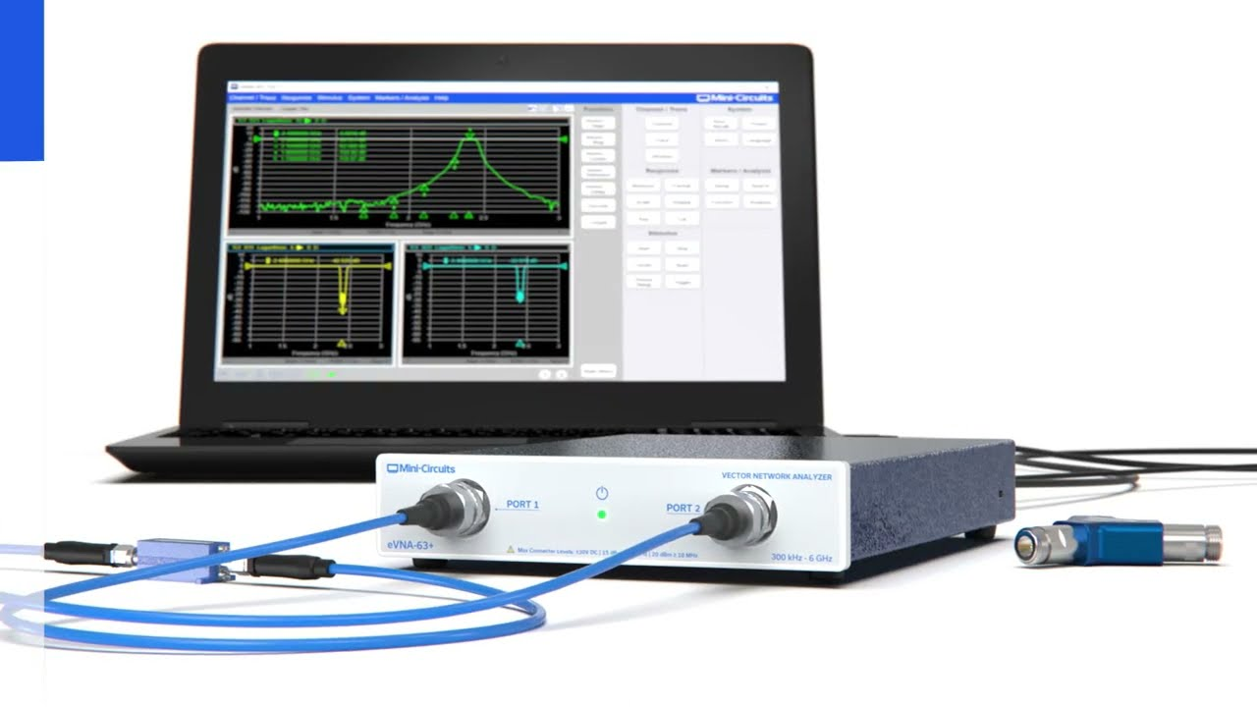
eVNA Experimental Setup

